Slide 1
HANDLING CONTRADICTORY KNOWLEDGE IN NARS
An analysis of belief revision and confidence dynamics
Shiven Patel · Omkar Brahmbhatt · Varshil Patel
AGI Course · April 2026

Slide 2
The question
Classical logic: one contradiction → explosion (anything derivable).
Real intelligence: tolerates contradictions, revises gracefully, keeps inferring.
NARS claims to do this via a graded truth-value system ⟨f, c⟩ and a revision formula rooted in evidence-counting.
Does it? And how does it deviate from the theoretical ideal under AIKR?
⟨f, c⟩
frequency
f = positive / total evidence
confidence
c = w / (w + 1)
NARS · Contradiction Handling · AGI Course Project 2026
2

Slide 3
How NARS combines contradictory evidence
NAL revision (Wang 2013, Ch. 4)
w⁺ = c₁·f₁/(1−c₁) + c₂·f₂/(1−c₂)
w⁻ = c₁·(1−f₁)/(1−c₁) + c₂·(1−f₂)/(1−c₂)
w = w⁺ + w⁻ · f = w⁺ / w · c = w / (w + 1)
Order-invariant
Confidence non-decreasing
Preserves inconsistency
Combining ⟨f₁, c₁⟩ then ⟨f₂, c₂⟩ gives the same result as the reverse.
Every independent observation adds evidence. c never goes down.
Different beliefs with disjoint evidence can coexist in memory.
NARS · Contradiction Handling · AGI Course Project 2026
3

Slide 4
Experimental design
10 scenarios across 3 families, all in standard Narsese (portable to Java OpenNARS and ONA)
Simple
Inference chain
Temporal
4 scenarios
3 scenarios
3 scenarios
Direct contradictions on a single statement — isolate the revision formula.
Contradiction affects a premise in a deduction chain.
Probe order effects and recent-vs-old evidence.
Examples:
Examples:
Examples:
S1: ⟨1.0, 0.9⟩ then ⟨0.0, 0.9⟩
S3: 4 positive + 1 negative
S4: alternating contradictions
C1: deduce, then contradict middle link
C2: the penguin problem
C3: 4-link chain
T1 vs T2: reversed order
T3: 8 positive then 4 negative
NARS · Contradiction Handling · AGI Course Project 2026
4

Slide 5
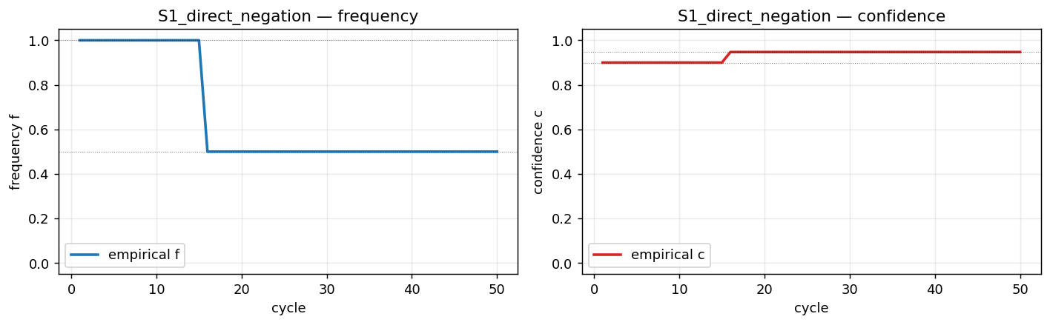
Result 1 — Two-input revisions match theory exactly
f → 0.500
c → 0.947
Match to 4 decimal places vs the closed-form formula.
Two equally-strong contradictory beliefs ⟨1.0, 0.9⟩ and ⟨0.0, 0.9⟩ merge to maximum uncertainty in frequency (f=0.5) while confidence INCREASES to 0.947 because the evidence base doubled. This is exactly what Wang 2013 predicts — and T1 vs T2 confirm order invariance: identical final state regardless of input order.
NARS · Contradiction Handling · AGI Course Project 2026
5

Slide 6
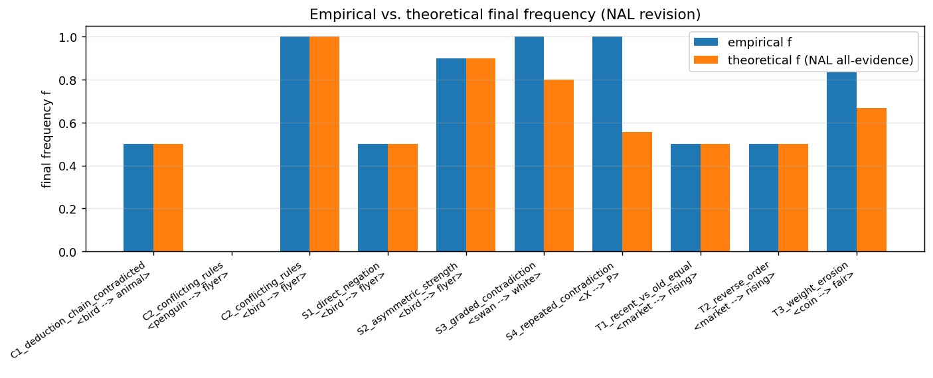
Result 2 — Multi-input revision is path-dependent under AIKR
Key finding
Empirical ≠ theoretical whenever 3+ revisable beliefs exist on the same term.
Why?
Revision only applies to pairs the control loop picks. Under AIKR, some pairs are never selected.
S3 evidence: 4 positive merged into Base{2014, 2020, 2026, 2038}, negative (Base{2032}) never folded in → final f = 1.0, not theoretical 0.8.
NARS · Contradiction Handling · AGI Course Project 2026
6

Slide 7
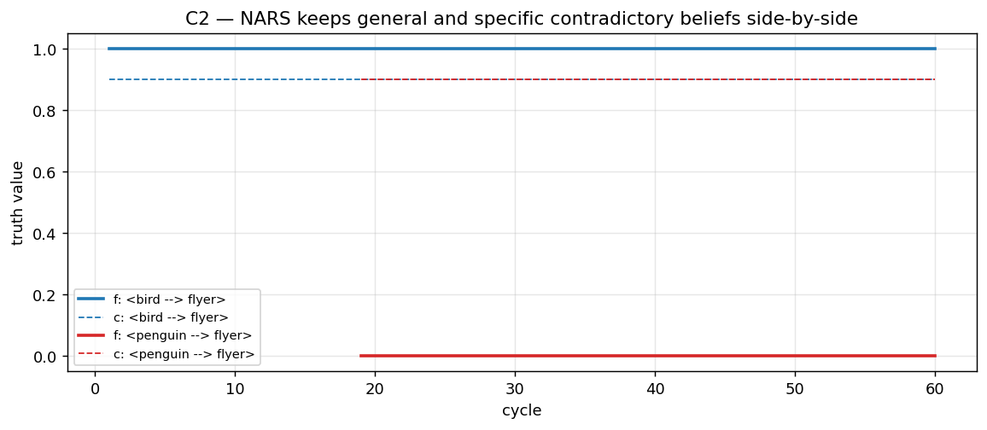
Result 3 — Graceful coexistence of general and specific
The penguin problem
<bird --> flyer>. ⟨1.0, 0.9⟩
<penguin --> bird>. ⟨1.0, 0.9⟩
<penguin --> flyer>. ⟨0.0, 0.9⟩
Both beliefs survive. NARS resolves them at query time — specific evidence wins over generic rule.
vs. AGM
AGM's priority rule would force consistency by deleting one of the beliefs — usually the general rule, discarding useful information. NARS keeps both and lets inference time pick the winner per query. Major architectural advantage for agents living in noisy worlds.
NARS · Contradiction Handling · AGI Course Project 2026
7

Slide 8
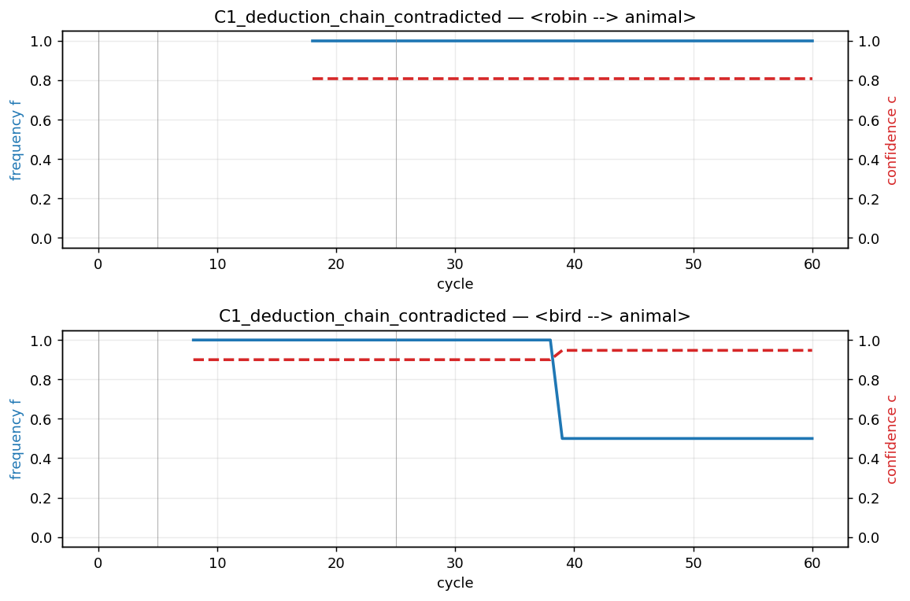
Result 4 — Revision does not propagate down inference chains
C1 scenario
1. <robin --> bird>.
2. <bird --> animal>.
→ deduces <robin --> animal>
3. <bird --> animal>. %0.0%
What happened
<bird --> animal> was revised to ⟨0.5, 0.947⟩ ✓
<robin --> animal> stayed at ⟨1.0, 0.81⟩ ✗
The derived conclusion is not updated when its premise is contradicted. Downstream beliefs become stale.
NARS · Contradiction Handling · AGI Course Project 2026
8

Slide 9
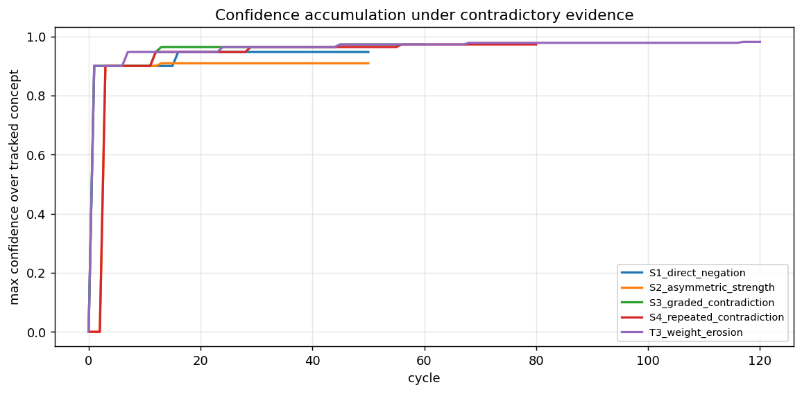
Result 5 — Confidence is monotonic under contradiction
Every step adds evidence, even when it makes the system LESS certain about direction (f→0.5). This is NARS's central trick: evidence accumulation ≠ agreement.
NARS · Contradiction Handling · AGI Course Project 2026
9

Slide 10
NARS vs. AGM vs. classical logic
Property | Classical logic | AGM | NARS
Contradiction ⇒ collapse? | Yes — explosion | No — forced consistency | No — graceful coexistence
Graded belief? | No | No | ⟨f, c⟩
Confidence grows with evidence? | — | No | Monotonic ✓
Order invariance? | Trivial (pure truth) | Depends on iteration rule | ✓ (verified in T1 vs T2)
Handles penguin problem? | ✗ | Needs default rules | Natively
Propagates revision downstream? | — | Yes (consistency) | ✗ (stale derivatives)
NARS · Contradiction Handling · AGI Course Project 2026
10

Slide 11
Takeaways
01
Revision formula works as advertised
Two-belief case: empirical matches theoretical ⟨f, c⟩ to machine precision.
02
Confidence accumulates, order doesn't matter
c is strictly non-decreasing. T1 and T2 (reversed order) reach identical state.
03
AIKR makes revision path-dependent
With 3+ inputs, final belief depends on which pairs attention selects. Not a bug — a feature of resource bounding.
04
Coexistence > consistency
NARS keeps contradictory general and specific beliefs side-by-side. Penguin problem has a natural solution.
05
Revision does not propagate downstream
Contradicting a premise does not automatically revise its descendants. Area for improvement.

Slide 12
Thank you.
Questions?
Full report and reproducible code: NARS_Project_Report.docx · experiments/ · analysis/
NARS · Contradiction Handling · AGI Course Project 2026
12

